Slide 1
DROWSINESS DETECTION SYSTEM IN INTELLIGENT VEHICLES WITH IMAGE PROCESSING

Slide 2
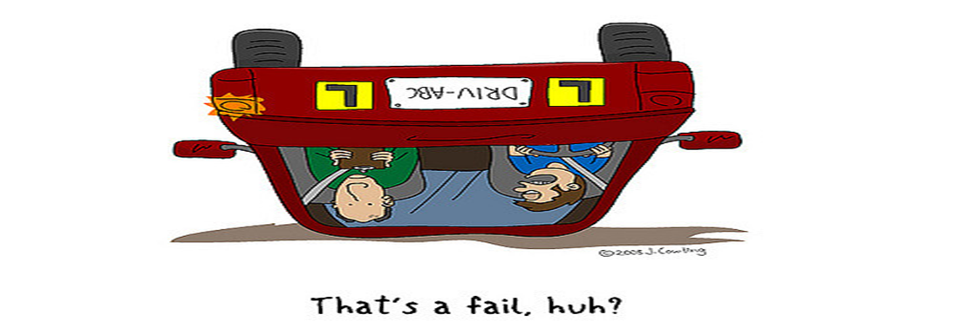

Slide 3
PROJECT MEMBERS
NAME | MOODLE ID
Akshay Kautkar | 15204011
Arvind Kumar Maurya | 15204023
Praneta Kasbe | 15204051
Shraddha Kedar | 15204007

Slide 4
INDEX
SR NO | CONTENT
1 | INTRODUCTION
2 | BACKGROUND
3 | ABSTRACT
4 | PROPOSED SYSTEM
5 | DESGIN
6 | TECHNOLOGY STACK
7 | PROJECT PLANNING

Slide 5
INTRODUCTION
It is a feeling of being sleepy lethargic; sleepiness.
For example:- a drug can cause drowsiness.
Most often, drowsiness becomes a problem because it interferes with normal daytime activities.
Drowsiness is a state of sleepiness. By implication, this is abnormal when it is -
Persistent
Occurs at inappropriate times or is excessive in nature.

Slide 6
Symptoms And Consequences
Quality of life may diminish.
Daytime naps become necessary, and can be embarrassing. At work, productivity decreases.
Mental changes: short-term memory is disturbed, attention span is shortened, energy levels drops as well.
Patients become more accident-prone.
Breathing problems are frequent, such as sleep apnoea.
Immune function is decreased.
There are changes in appetite

Slide 7
CAUSES
Medication side effects – Cold/Cough medicines, some painkillers
Poor sleep quality/quantity
Underlying medications – Very high/low blood sugar in poorly managed diabetes, low sodium in blood as well.
Alcohol consumption – Consumption of alcohol is strictly prohibited by the government of all countries.

Slide 8
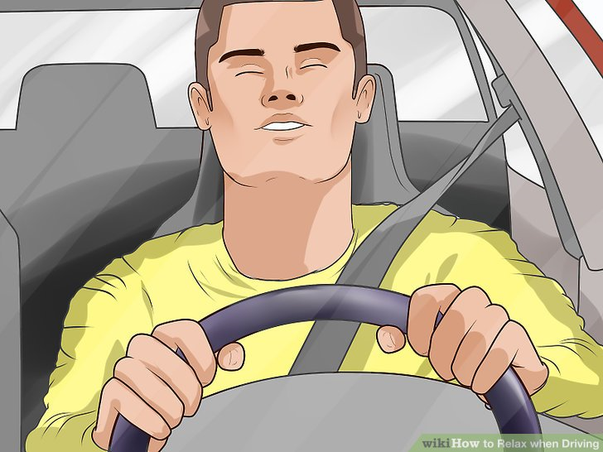
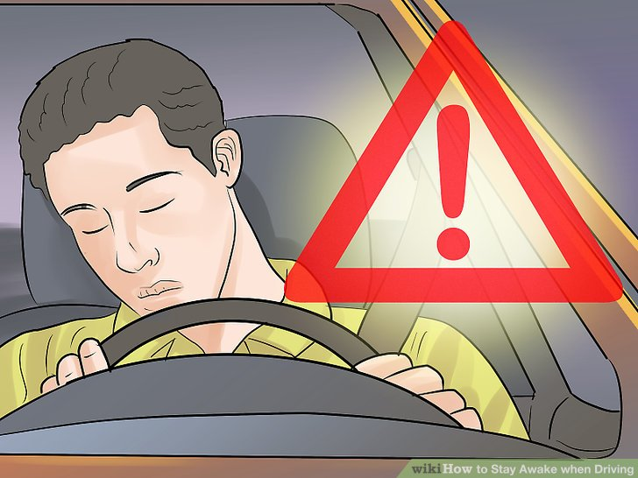
IILUSTRATIONS

Slide 9
BACKGROUND
In recent years, because of the need for public transportation cars and motorcycles grow at a rapid rate.
Recent statistics estimate that annually 1,200 deaths and 76,000 injuries can be attributed to fatigue related crashes
The reasons for traffic accidents become much more complex, general transport system has been inadequate.
The driver’s fatigue recognition system is part of ITS vehicles active safety system.

Slide 10
At present, number of safety devices are used in vehicles to protect the driver (seat belts, airbags, brakes system and hard sheet metal)
However, these devices always act after the accident happened.
There are less of equipments can warn before the accidents.
Driver fatigue recognition system hopes to warn driver when they are fatigued, and avoid traffic accidents.

Slide 11
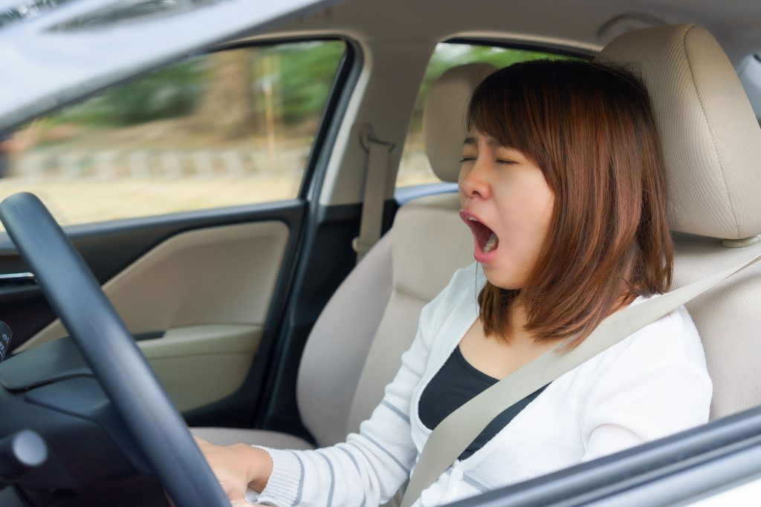
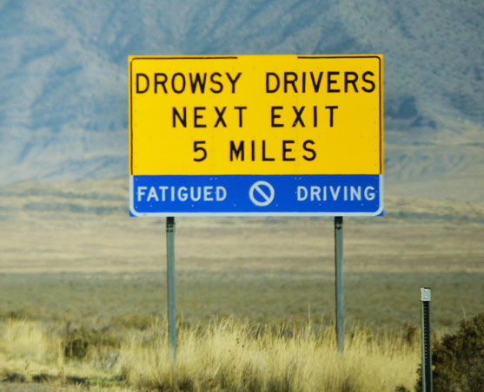

Slide 12
ABSTRACT
To implement a computer vision-based recognition system.
To detect human face in different light sources.
To track drivers eyes are open or closed.
To track driver’s activity and monitor visual attention with camera

Slide 13
PROPOSED SYSTEM
A Drowsy Driver Detection System is going to be developed by using a non-intrusive machine vision based concepts.
The aim of this project is to develop a prototype drowsiness detection system. The focus will be placed on designing a system that will accurately monitor the open or closed state of the driver’s eyes in real-time.
The system uses a camera that points directly towards the driver’s face and monitors the driver’s eyes in order to detect fatigue.

Slide 14
By monitoring the eyes, it is believed that the symptoms of driver fatigue can be detected early enough to avoid a car accident.
Detection of fatigue involves a sequence of images of a face, and the observation of eye movements and blink patterns.
This project will be focused on the localization of the eyes, which involves looking at the entire image of the face, and determining the position of the eyes by a self developed image-processing algorithm. Once the position of the eyes is located, the system is designed to determine whether the eyes are opened or closed, and detect fatigue
And Physical changes such as sagging posture and leaning of driver’s head.

Slide 15
SYSTEM PROCESS
Eye Detection Function
Inputting a facial image, pre-processing is first performed by finalizing the image. The top end sides of the face are detected to narrow down the area of where the eyes exists.
Using the sides of the face, the center of the face is found, which will be used as a reference when comparing the left and right eyes.
Moving down from the top of the face, horizontal averages (average intensity value for each y coordinate) of the face area are calculated. Large changes in the averages are used to define the eye area.

Slide 16
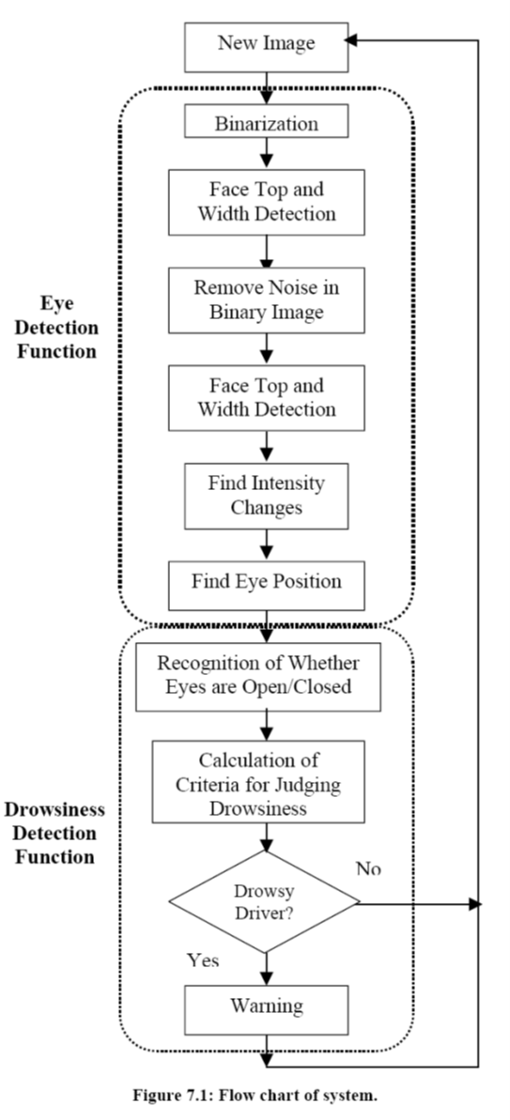
DESIGN

Slide 17
ENGINEERING APPROACH
Computer Vision Technology
It is process of extracting structures or answers from images or video and applying mathematical methods to data to extract or recognize patterns.
Computer Vision is mimicking the abilities of human vision by electronically perceiving and understanding an image.
It is a broad term and includes a lot of domains like Gesture Recognition, Optical Character Recognition, Face detection and a lot more.

Slide 18
ENGINEERING APPROACH
Open Source Computer Vision
OpenCV is a library of programming functions mainly aimed at real-time computer vision.
Originally developed by Intel, it was later supported by Willow Garage then Itseez (which was later acquired by Intel).
The library is cross-platform and free for use under the open-source-BSD license.
OpenCV runs on the following desktop operating systems: Windows, Linux, macOS, FreeBSD, NetBSD, OpenBSD.
OpenCV runs on the following mobile operating systems: Android, iOS, Maemo, BlackBerry 10.

Slide 19
APPLICATIONS
2D and 3D feature toolkits
Egomotion estimation
Facial recognition system
Gesture recognition
Human–computer interaction (HCI)
Mobile robotics
Motion understanding
Object identification
Segmentation and recognition
Stereopsis stereo vision: depth perception from 2 cameras
Structure from motion (SFM)
Motion tracking
Augmented reality

Slide 20
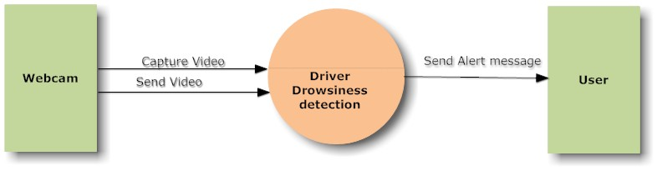
UML DIAGRAM

Slide 21
TECHNOLOGY STACK
HARDWARE | SPECIFICATION
RAM | 4 GB
HARD DISK | 160 GB
PROCESSOR | INTEL PROCESSOR IV
WEB CAMERA | -

Slide 22
SOFTWARE | SPECIFICATION
OPERATING SYSTEM | WINDOWS
TECHNOLOGY USED | .NET
DATABASE | MS SQL SERVER 2005
SOFTWARE | VISUAL STUDIO 2008

Slide 23
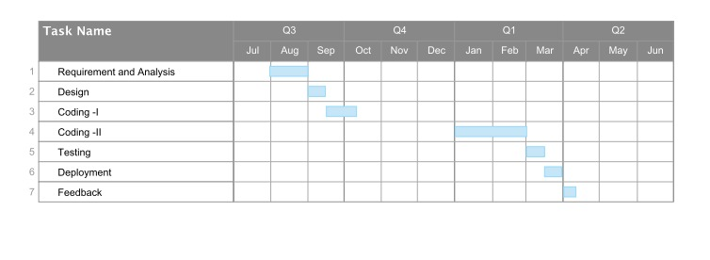
PROJECT PLANNING

Slide 24
THANK YOU !!!

